Slide 1

FINAL PROJECT DEMONESTRATION
EEE 4XXX: ELECTRICAL AND ELECTRONICS LABORATORY
PROJECT TITLE: Design of Voltage Divider Circuit
Submitted by – Group A.XY
First Name M. Last Name
200021XYZ
First Name M. Last Name
200021XYZ
First Name M. Last Name
200021XYZ
First Name M. Last Name
200021XYZ
Creating Global Citizens Rooted with Islamic Values

Slide 2


OUTLINE
ABSTRACT
INTRODUCTION
DESIGN METHODS
SCHEMATIC DESIGN
RESULT ANALYSIS
LIMITATIONS AND PROBLEMS FACED

Slide 3
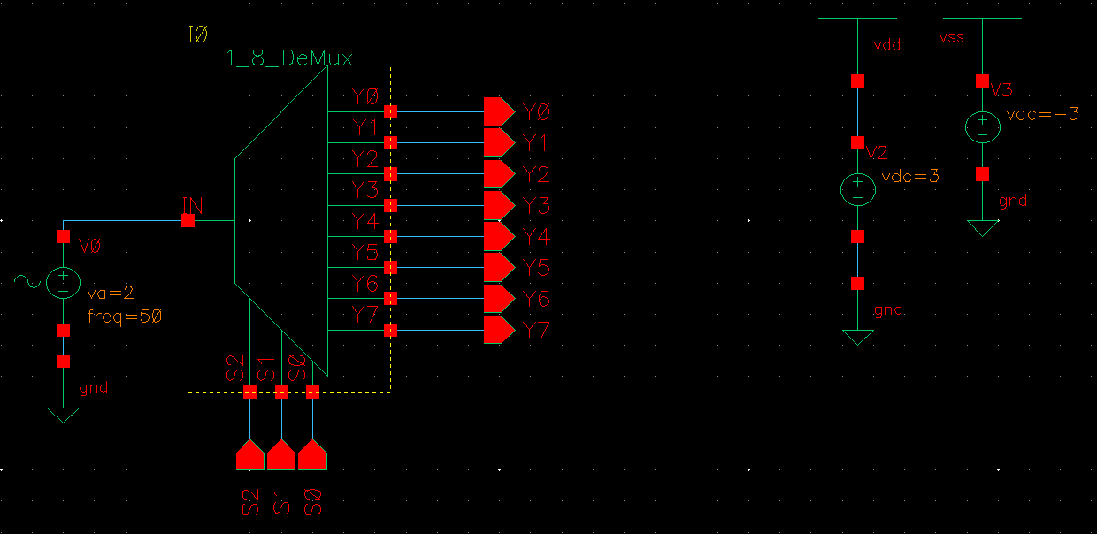
ABSTRACT

Slide 4
ABSTRACT
TO DESIGN A HIGH-PERFORMANCE 1:8 ANALOG DEMULTIPLEXER
IMPLEMENTED USING TRANSMISSION GATES (TGS) FOR LOW ON-RESISTANCE AND HIGH LINEARITY
THE FINAL DESIGN ACHIEVED AN ON-RESISTANCE OF < 15 Ω, A BW OF > 1.5 MHZ, AND A POWER DISSIPATION OF 10.5 MW

Slide 5

INTRODUCTION
WHAT IS 1:8 ANALOG DEMUX?

Slide 6

INTRODUCTION
Y0
Y1
Y2
Y3
INPUT
Y4
Y5
Y6
Y7
S2
S1
S0
0
0
0
OUTPUT

Slide 7
INTRODUCTION
Y0
Y1
Y2
Y3
INPUT
Y4
Y5
Y6
Y7
S2
S1
S0
0
0
1
OUTPUT

Slide 8
INTRODUCTION
Y0
Y1
Y2
Y3
INPUT
Y4
Y5
Y6
Y7
S2
S1
S0
0
1
0
OUTPUT

Slide 9
INTRODUCTION
Y0
Y1
Y2
Y3
INPUT
Y4
Y5
Y6
Y7
S2
S1
S0
1
0
1
OUTPUT

Slide 10

INTRODCUTION
DATA ACQUISITION SYSTEMS (DAQS)
COMMUNICATIONS SYSTEMS
AUTOMATED TEST EQUIPMENT (ATE)
AUDIO & VIDEO SIGNAL ROUTING

Slide 11

INTRODUCTION
THE NEED TO HANDLE BIPOLAR SIGNALS (-2V TO +2V)
DIGITAL LOGIC LOW LEVEL = 0V AND HIGH LEVEL = 1.4V
THE NEED FOR LEVEL SHIFTING

Slide 12
INTRODUCTION
PARAMETERS | VALUES
SUPPLY VOLTAGE | ±3 V
LOGIC HIGH LEVEL | 0 V
LOGIC LOW LEVEL | 1.4 V
INPUT CAPACITANCE (MAX) | 45-50 pF
CHARGE INJECTION OVER THE FULL SIGNAL SWING RANGE (MAX) | 4-8 pC
SWITCHING ON TIME (TON) (AT RL = 1KΩ, CL = 10 PF) (MAX) | 100 ns
ANALOG SIGNAL RANGE | ±2
POWER DISSIPATION (MAX) | 10-15 mW
ON-RESISTANCE | 5-15 Ω
BANDWIDTH, -3 DB | 1.25 MHz

Slide 13

DESIGN METHODS
TRANSMISSION GATE LOGIC
CMOS INVERTER
LEVEL SHIFTER USING SUMMING AMPLIFIER

Slide 14
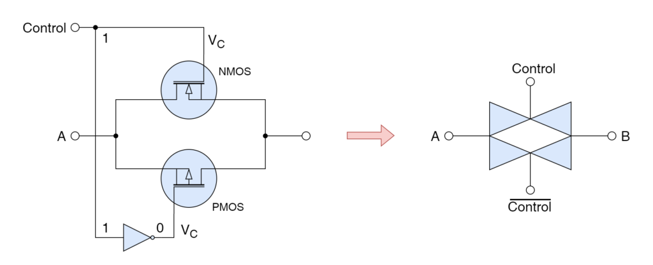
TRANSMISSION GATE LOGIC

Slide 15
TRANSMISSION GATE LOGIC
ANALOG SWITCH
WHEN CONTROL = 1, B = A
WHEN CONTROL = 0, B = HI

Slide 16
TRANSMISSION GATE LOGIC
CMOS INVERTER
WHEN CONTROL = 1, B = A
WHEN CONTROL = 0, B = HI
A
B
A
B
PMOS ON, NMOS ON
PMOS OFF, NMOS OFF

Slide 17
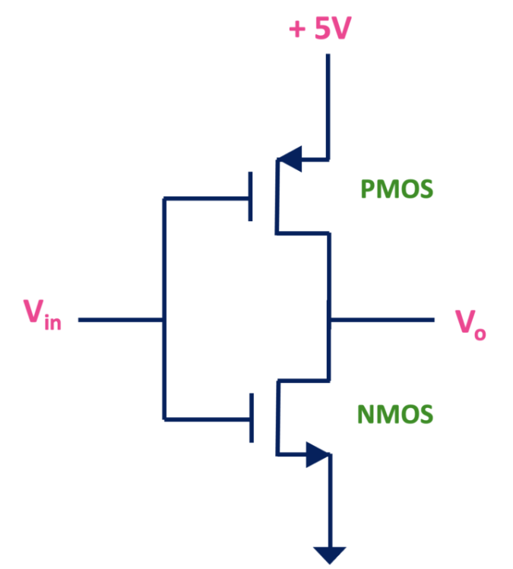
TRANSMISSION GATE LOGIC
CMOS INVERTER

Slide 18
LEVEL SHIFTER
CMOS INVERTER
Vout = Vin’
Vout CANNOT BE PULLED DOWN BELOW 0V

Slide 19
CMOS INVERTER
LEVEL SHIFTER
3 V
1.4 V
0 V
0 V
-3 V

Slide 20
CMOS INVERTER
LEVEL SHIFTER
1.4 V
0 V
AMPLIFY THE SIGNAL

Slide 21
CMOS INVERTER
LEVEL SHIFTER
6 V
0 V
AMPLIFY THE SIGNAL

Slide 22
CMOS INVERTER
LEVEL SHIFTER
3 V
0 V
-3 V
SHIFT THE SIGNAL

Slide 23
HMM… EASIER SAID THAN DONE

Slide 24
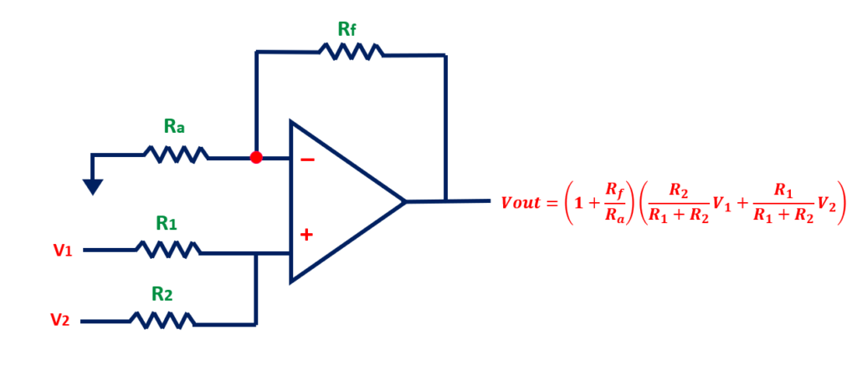
CMOS INVERTER
SUMMING AMPLIFIER

Slide 25
CMOS INVERTER
SUMMING AMPLIFIER
INPUT SIGNAL V1 (0 TO 1.4V)
Rf AND Ra FOR AMPLIFYING
DC BIAS V2 FOR SHIFTING

Slide 26
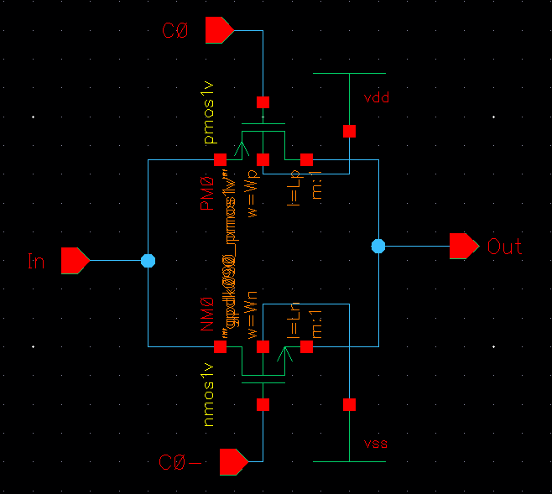
SCHEMATIC DESIGN
TRANSMISSION GATE LOGIC

Slide 27
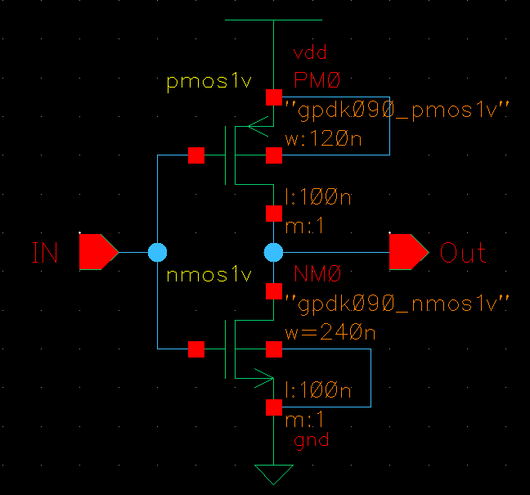
CMOS INVERTER
TRANSMISSION GATE LOGIC

Slide 28
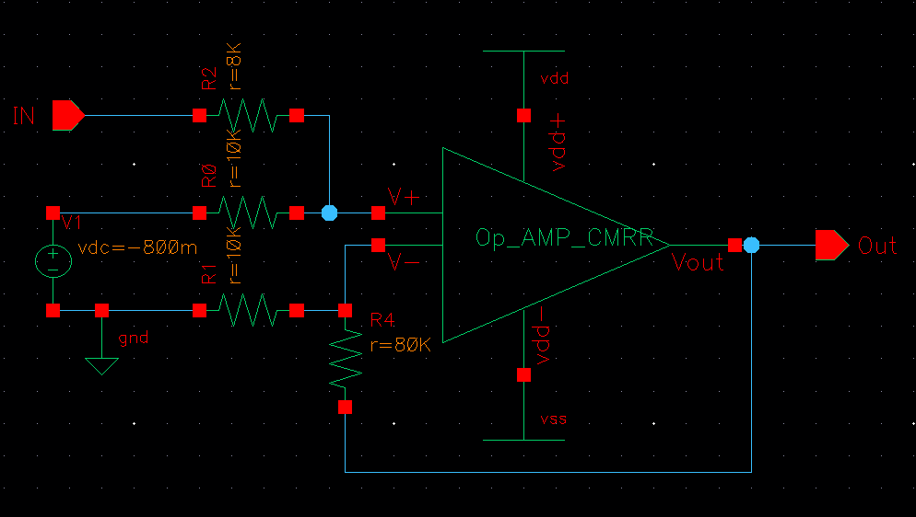
TRANSMISSION GATE LOGIC
LEVEL SHIFTER
CMOS INVERTER

Slide 29
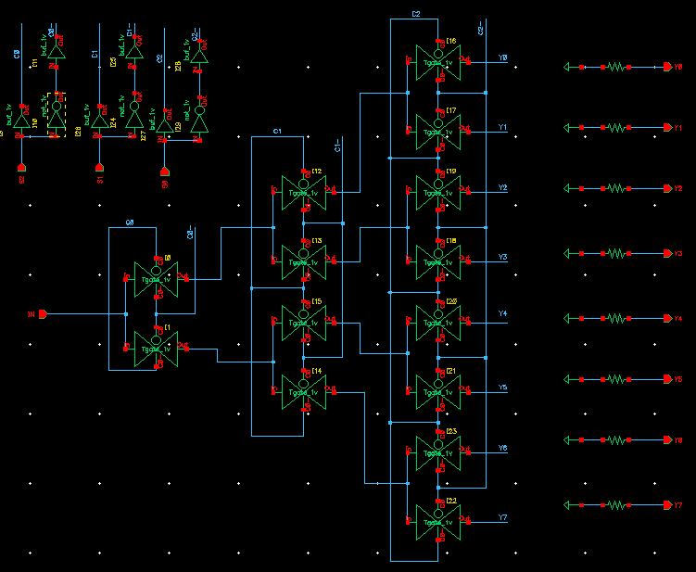
CMOS INVERTER
WHOLE SCHEMATIC
LEVEL SHIFTER

Slide 30
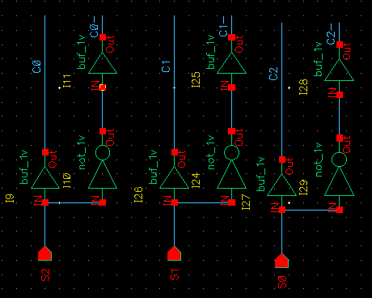
LEVEL SHIFTER
SWITCH MODULE
WHOLE SCHEMATIC

Slide 31
WHOLE SCHEMATIC
SWITCH MODULE

Slide 32
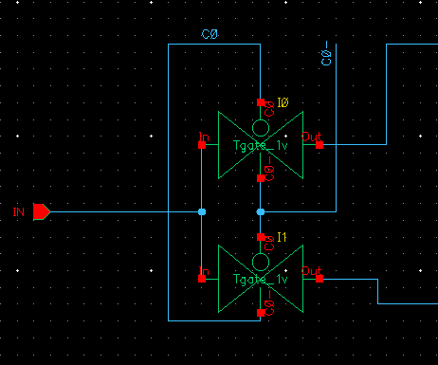
SWITCH MODULE
DEMUX USING TG

Slide 33
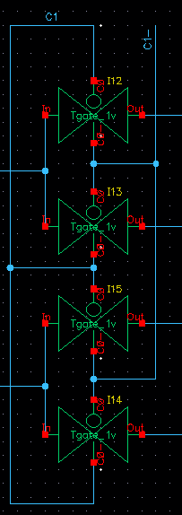
SWITCH MODULE
DEMUX USING TG

Slide 34
SWITCH MODULE
DEMUX USING TG

Slide 35
SWITCH MODULE
DEMUX USING TG

Slide 36
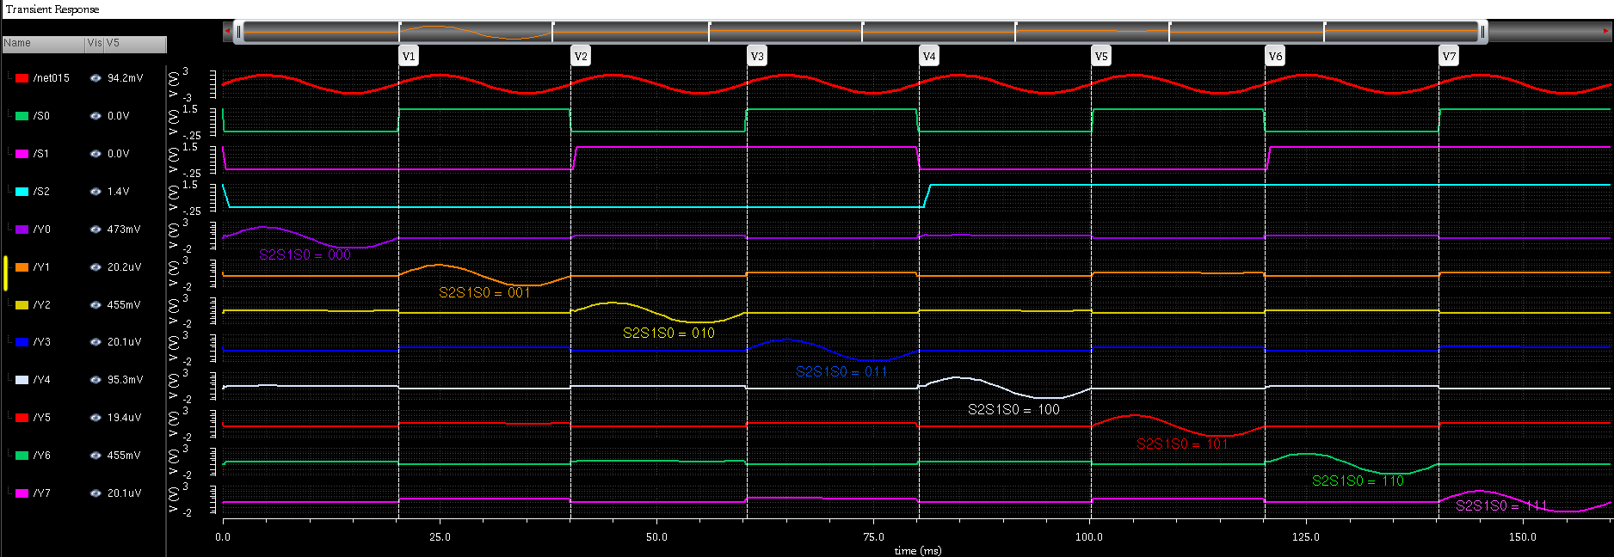
RESULT ANALYSIS
DEMUX OUTPUT

Slide 37
RESULT ANALYSIS
DEMUX OUTPUT

Slide 38
RESULT ANALYSIS
DEMUX OUTPUT

Slide 39
RESULT ANALYSIS
DEMUX OUTPUT

Slide 40
RESULT ANALYSIS
DEMUX OUTPUT

Slide 41
RESULT ANALYSIS
DEMUX OUTPUT

Slide 42
RESULT ANALYSIS
DEMUX OUTPUT

Slide 43
RESULT ANALYSIS
DEMUX OUTPUT

Slide 44
RESULT ANALYSIS
DEMUX OUTPUT

Slide 45
RESULT ANALYSIS
DEMUX OUTPUT

Slide 46
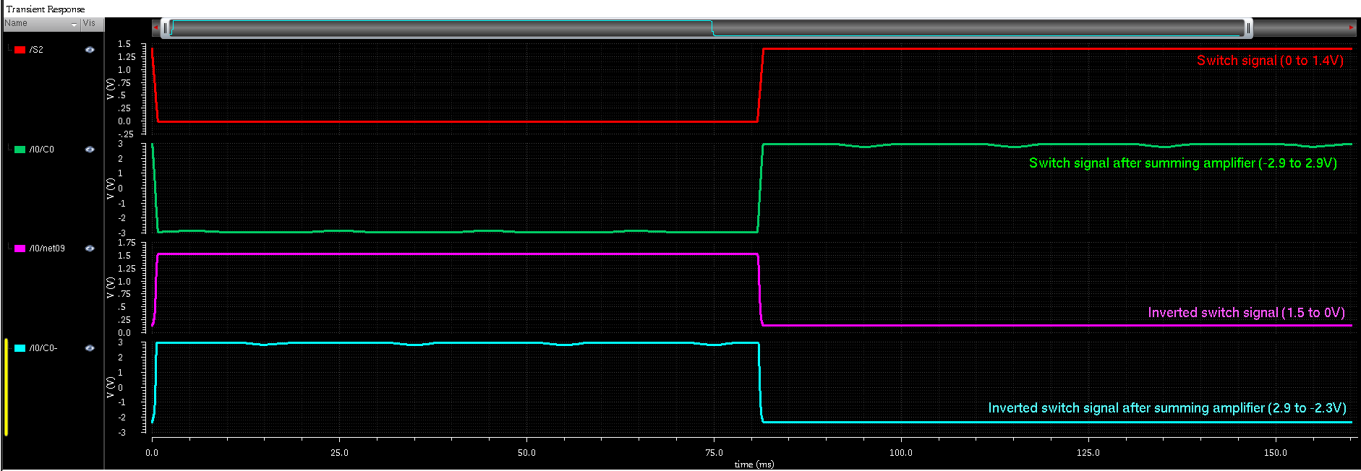
RESULT ANALYSIS
SWITCH OUTPUT

Slide 47
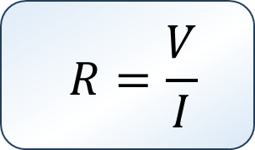
ON RESISTANCE (Ron)
INDEPENDENT SOURCES ARE TURNED OFF, 1V DC SUPPLY PROVIDED.
I
CURRENT PLOTTED AGAINST VOLTAGE USING DC SWEEP ANALYSIS.
-+
1 V
ON RESISTANCE CALCULATED THROUGH OHM’S LAW.
$$R=\frac{V}{I}$$

Slide 48
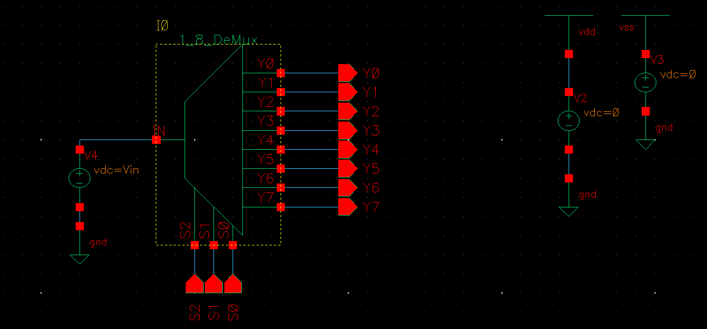
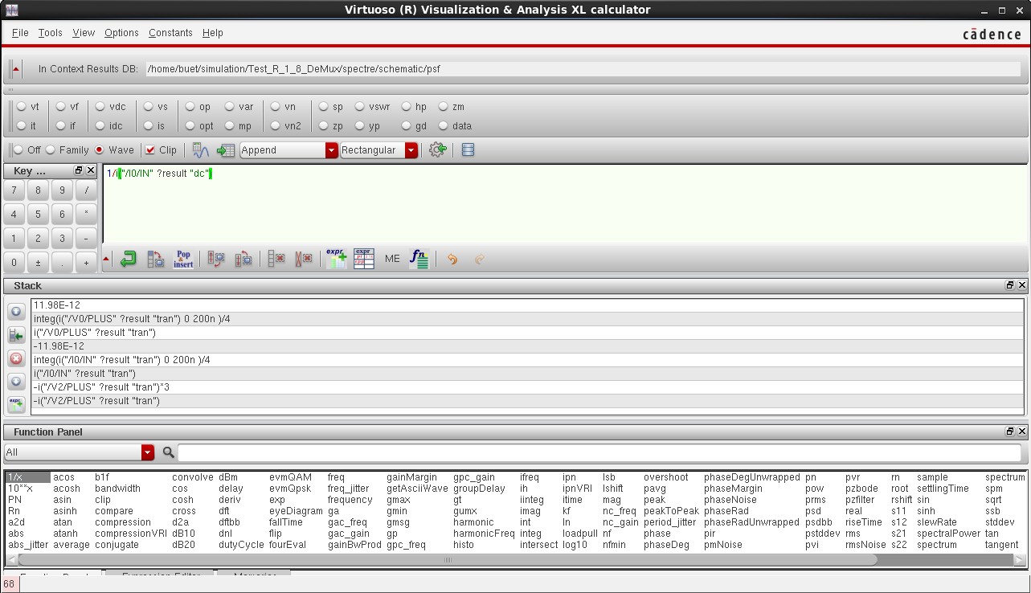
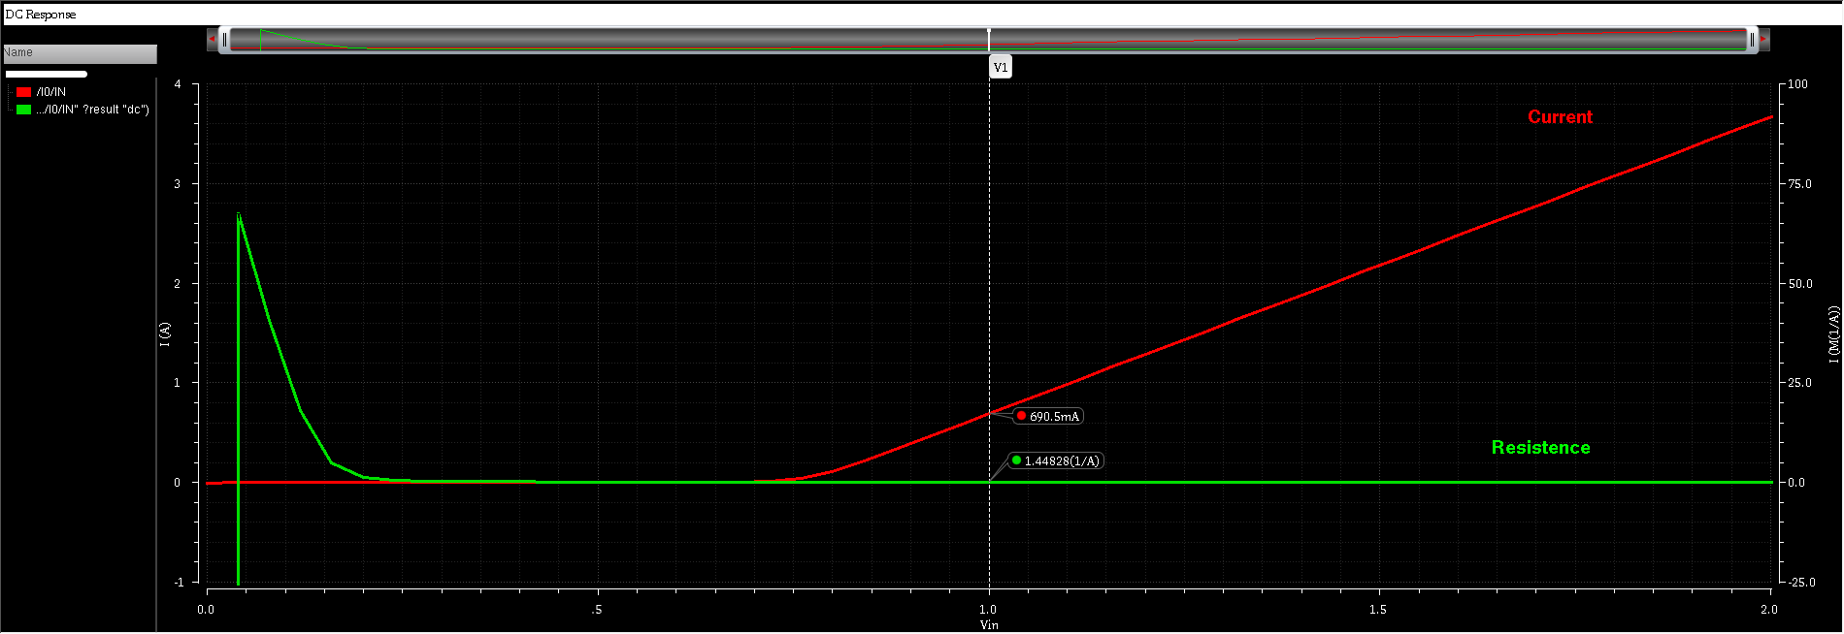
ON RESISTANCE (Ron)

Slide 49
ON RESISTANCE (Ron)

Slide 50
ON RESISTANCE (Ron)

Slide 51
ON RESISTANCE (Ron)

Slide 52
ON RESISTANCE (Ron)

Slide 53
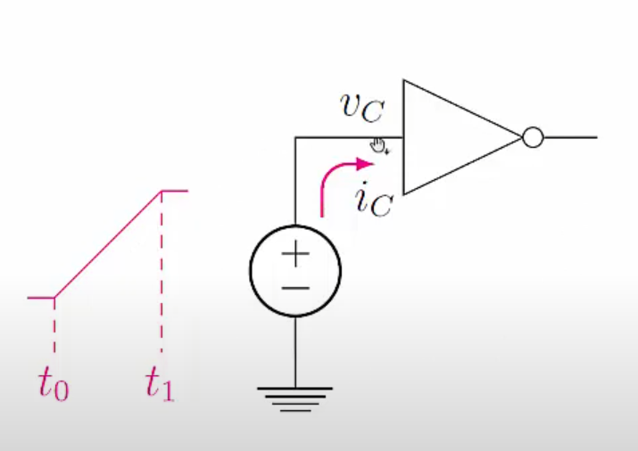

INPUT CAPACITANCE
RAMP VOLTAGE IS PROVIDED IN THE INPUT.
CURRENT FOR THE GIVEN RAMP VOLTAGE INPUT IS CALCULATED.
$$C=\frac{1}{v_{C}}\int_{t_{0}}^{t_{1}}{i_{C}\left(t\right)dt}$$
CAPACITANCE VIA THE SHOWN FORMULA BY INTEGRATING CURRENT OVER THE RAMP PERIOD.

Slide 54
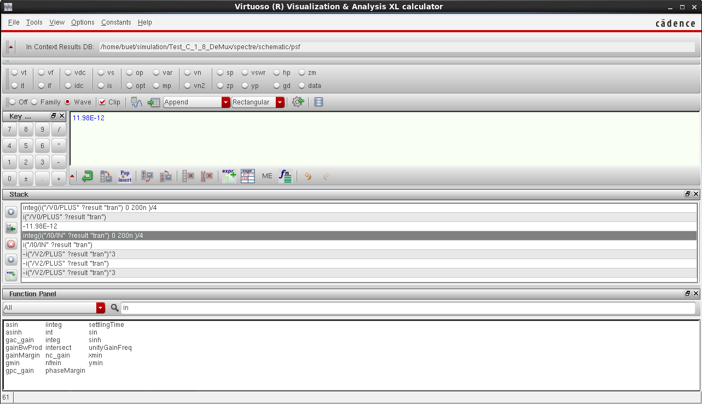
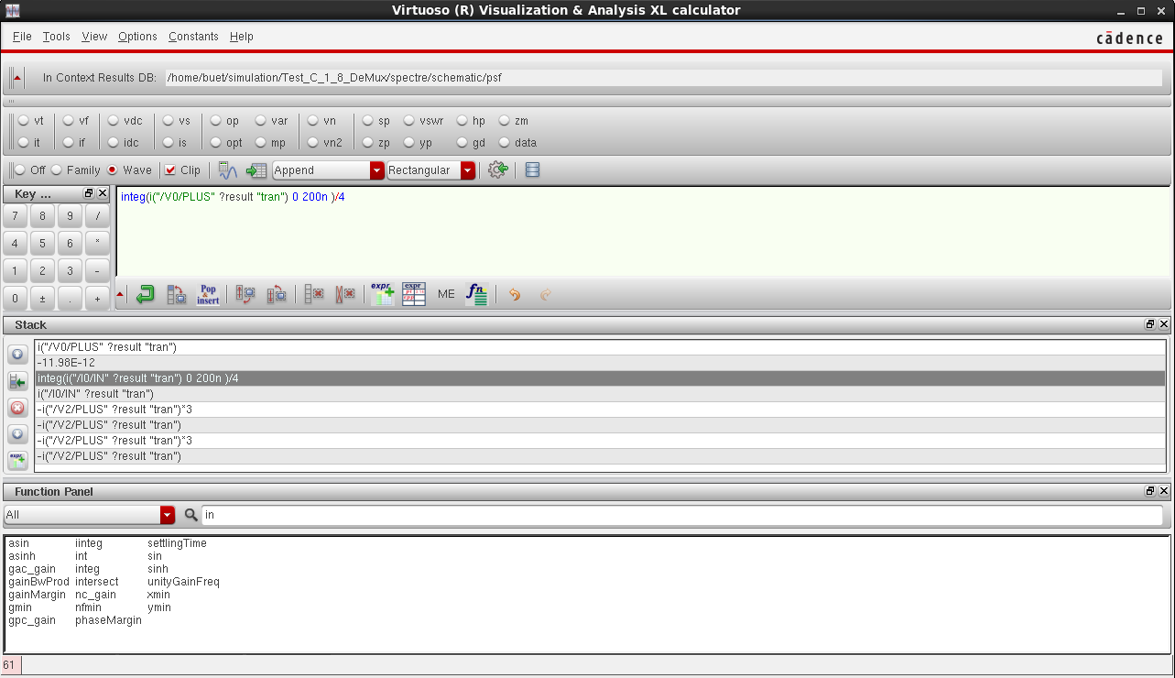
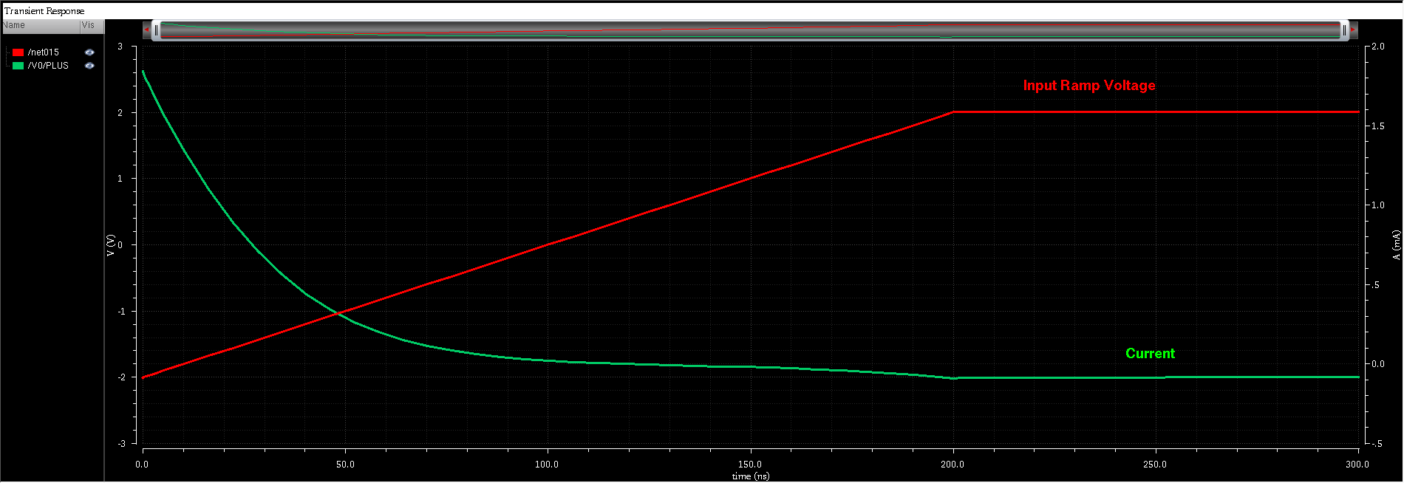
INPUT CAPACITANCE

Slide 55
INPUT CAPACITANCE

Slide 56
INPUT CAPACITANCE

Slide 57

POWER DISSIPATION
THE AMOUNT OF POWER CONSUMED BY THE DEMUX AND LOST AS HEAT.
MAXIMUM CURRENT ENTERING THE DEMUX IS CALCULATED THROUGH TRANSIENT ANALYSIS.
THE DISSIPATED POWER IS CALCULATED BY MULTIPLYING THE MAXIMUM CURRENT WITH THE SUPPLY VOLTAGE.

Slide 58
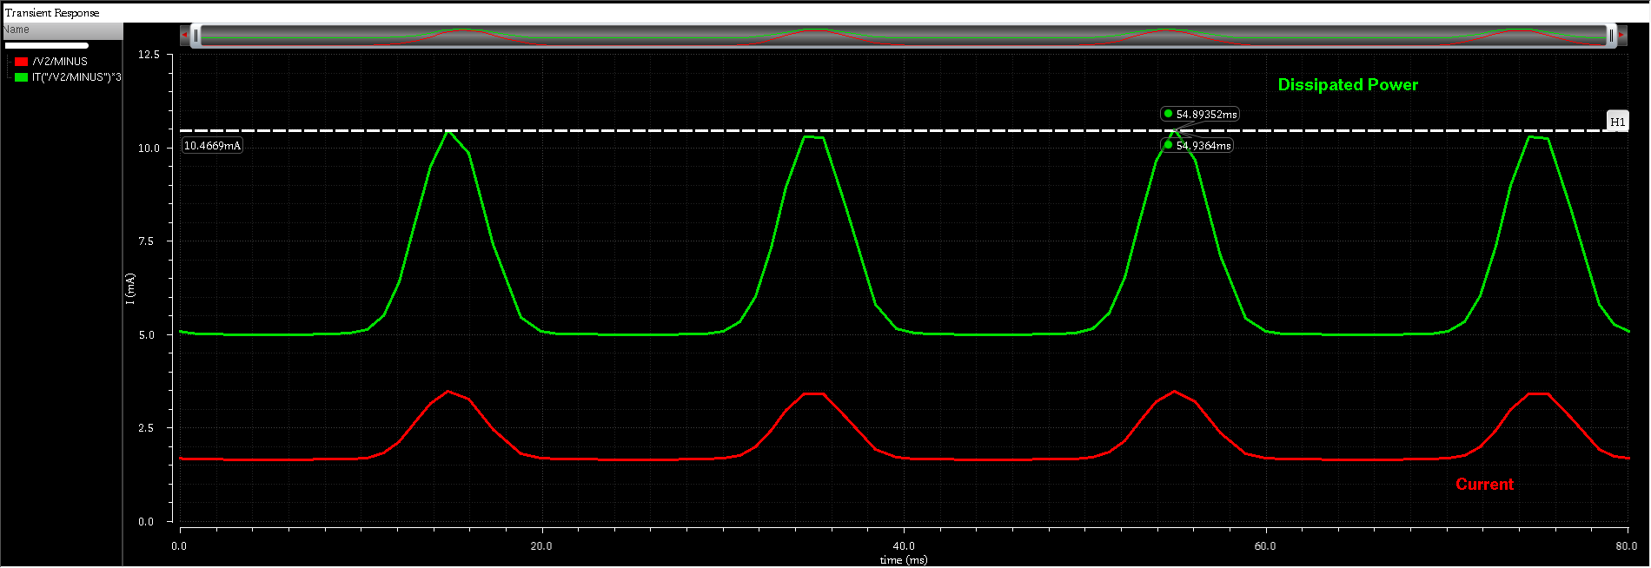
POWER DISSIPATION

Slide 59
POWER DISSIPATION

Slide 60
SWITCHING ON TIME (Ton)
THE INTERVAL FROM THE PREVIOUS CHANNEL’S DE-ASSERTION TO THE NEW CHANNEL REACHING CONUDCTION & VICE VERSA.
SHOWS CHANNEL TO CHANNEL DELAY AND EFFECTIVE SAMPLING APERTURE.

Slide 61
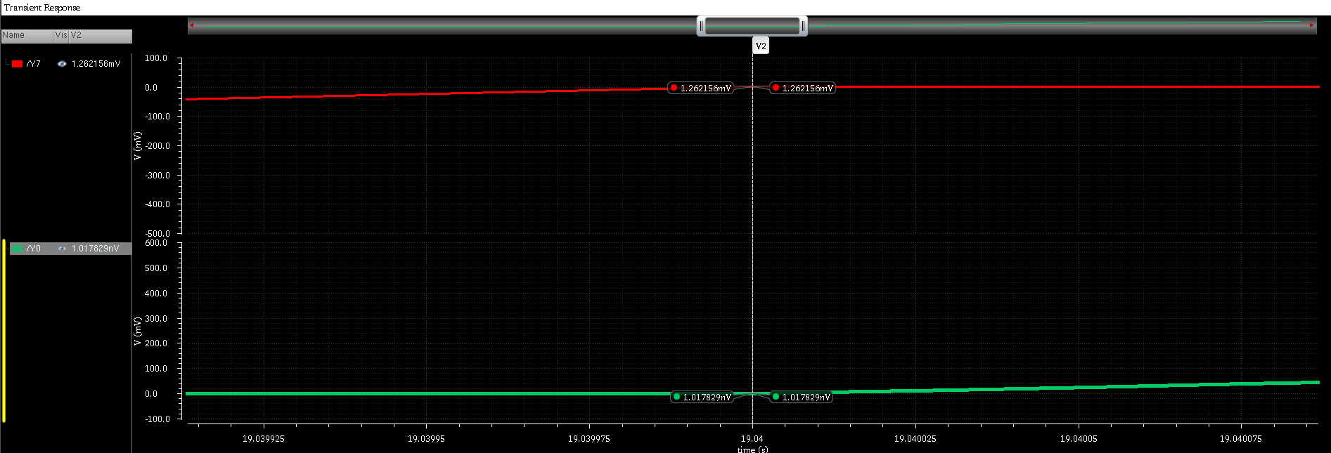
SWITCHING ON TIME (Ton)
Ton = 19.040000480-19.040000000 = 480ns

Slide 62
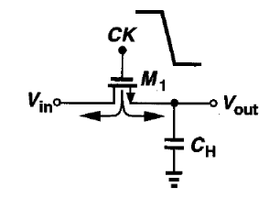
CHARGE INJECTION
EXPULSION OF CHANNEL CHARGE INTO SOURCE/DRAIN & OTHER NODES WHEN MOSFET IS TURNED OFF.
TRANSIENT ANALYSIS PERFORMED TO FIGURE OUT THE CURRENT IN EACH TRANSMISSION GATE.
CURRENT INTEGRATED THROUGHOUT THE SIGNAL PERIOD TO FIND THE CHARGE ACCUMULATION.

Slide 63
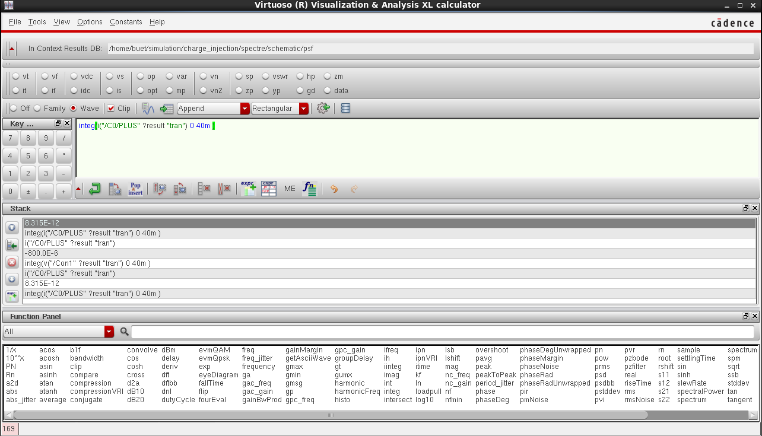
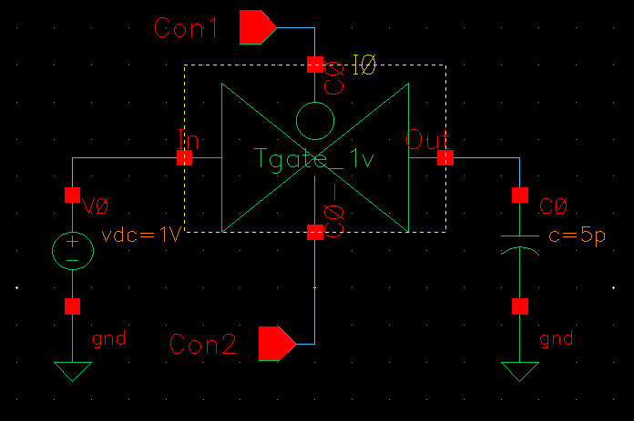
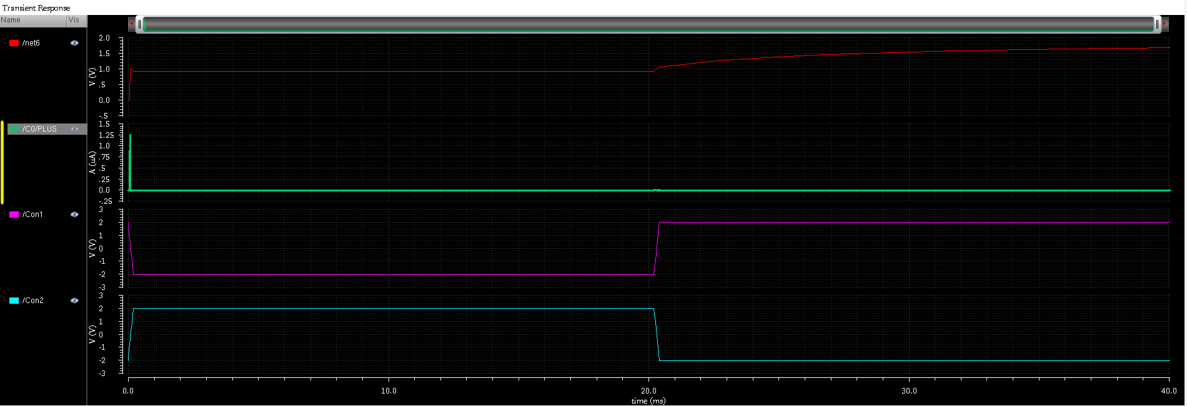
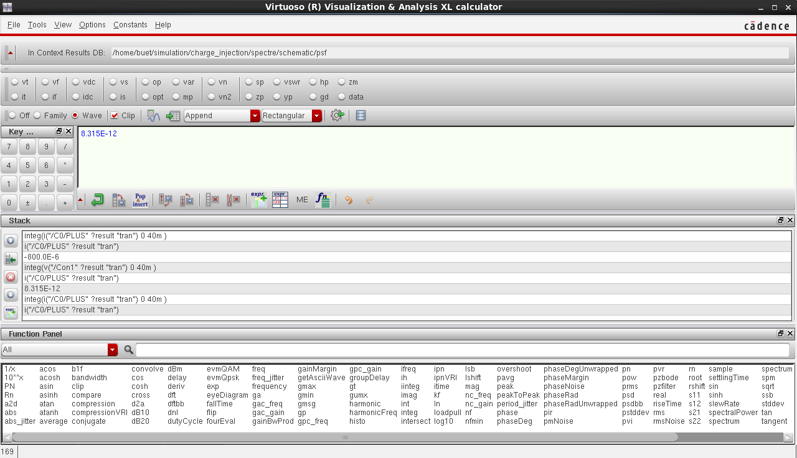
CHARGE INJECTION

Slide 64
CHARGE INJECTION

Slide 65
CHARGE INJECTION

Slide 66
CHARGE INJECTION

Slide 67
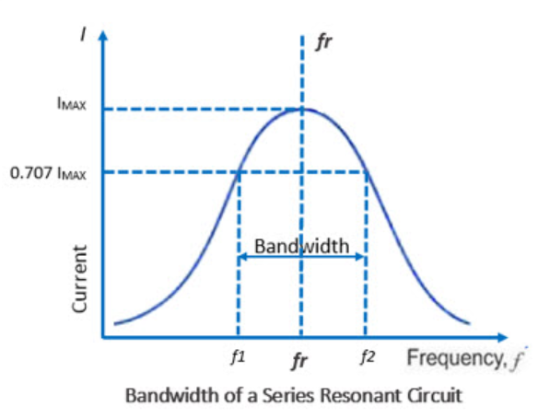
BANDWIDTH
DIFFERENCE BETWEEN UPPER AND LOWER -3dB FREQUENCY.
CAPACITIVE LOAD ATTACHED AND AC ANALYSIS PERFORMED.
GAIN & PHASE PLOTTED AND BANDWIDTH CALCULATED AT -3dB FREQUENCY.

Slide 68
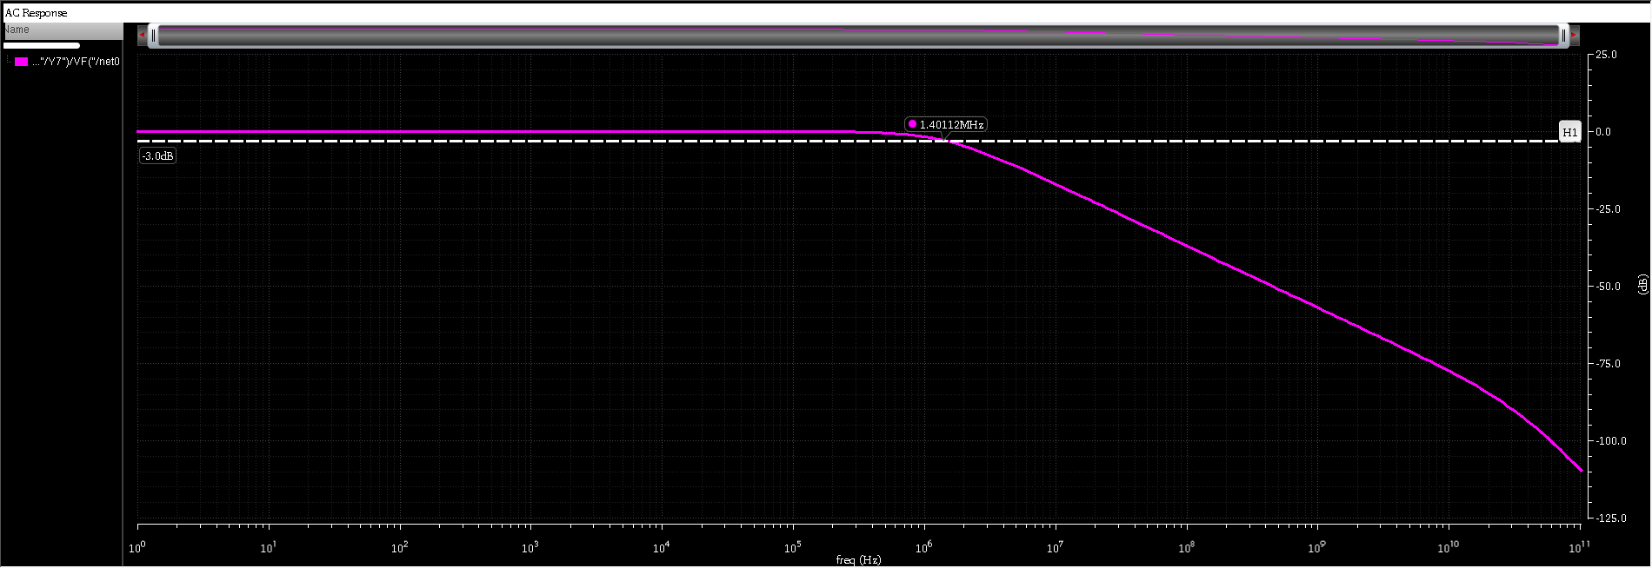
BANDWIDTH

Slide 69
BANDWIDTH

Slide 70


LIMITATIONS
OUTPUT SWING 1.98 TO -1.8V
LESS RESISTANCE & CAPACITANCE THAN THE GIVEN RANGE
HIGHER TON THAN THE GIVEN THRESHOLD VALUE

Slide 71


PROBLEMS FACED
LACK OF BACKGROUND KNOWLEDGE
LACK OF USEFUL RESOURCES
NO. OF GIVEN PARAMETERS
DESIGNING LEVEL SHIFTER

Slide 72
CONCLUSION
PARAMETERS | GIVEN VALUES | OUR RESULTS
SUPPLY VOLTAGE | ±3 V | ±3 V
LOGIC HIGH LEVEL | 0 V | 0 V
LOGIC LOW LEVEL | 1.4 V | 1.4 V
INPUT CAPACITANCE (MAX) | 45-50 pF | 11.98 pF
CHARGE INJECTION OVER THE FULL SIGNAL SWING RANGE (MAX) | 4-8 pC | 8.315 pC
SWITCHING ON TIME (TON) (AT RL = 1KΩ, CL = 10 PF) (MAX) | 100 ns | 480 ns
ANALOG SIGNAL RANGE | ±2 | ±2
POWER DISSIPATION (MAX) | 10-15 mW | 10.4669 mW
ON-RESISTANCE | 5-15 Ω | 1.45 Ω
BANDWIDTH, -3 DB | 1.25 MHz | 1.40112 MHz

Slide 73



2
Creating Global Citizens Rooted with Islamic Values

